Slide 1


ICS499 – Software Engineering and Capstone Project
Welcome to ICS499, where theory meets practice in an intensive exploration of software engineering principles and hands-on project development. This course combines foundational software engineering concepts with real-world application through a comprehensive capstone project experience.
Instructor
Siva Jasthi
Computer Science and Cybersecurity
Metropolitan State University

Slide 2

Course Structure Overview
This course is thoughtfully designed around two complementary pillars that work together to build your software engineering expertise. The theoretical foundation provides essential knowledge, while the practical application through your capstone project ensures you can apply these concepts in real-world scenarios.
Software Engineering Foundations
Comprehensive coverage of industry-standard methodologies, development processes, and best practices that form the backbone of professional software development.
Capstone Project Development
Hands-on application of learned concepts through an intensive 10-week project where you'll design, develop, and deploy a fully functional software application.

Slide 3
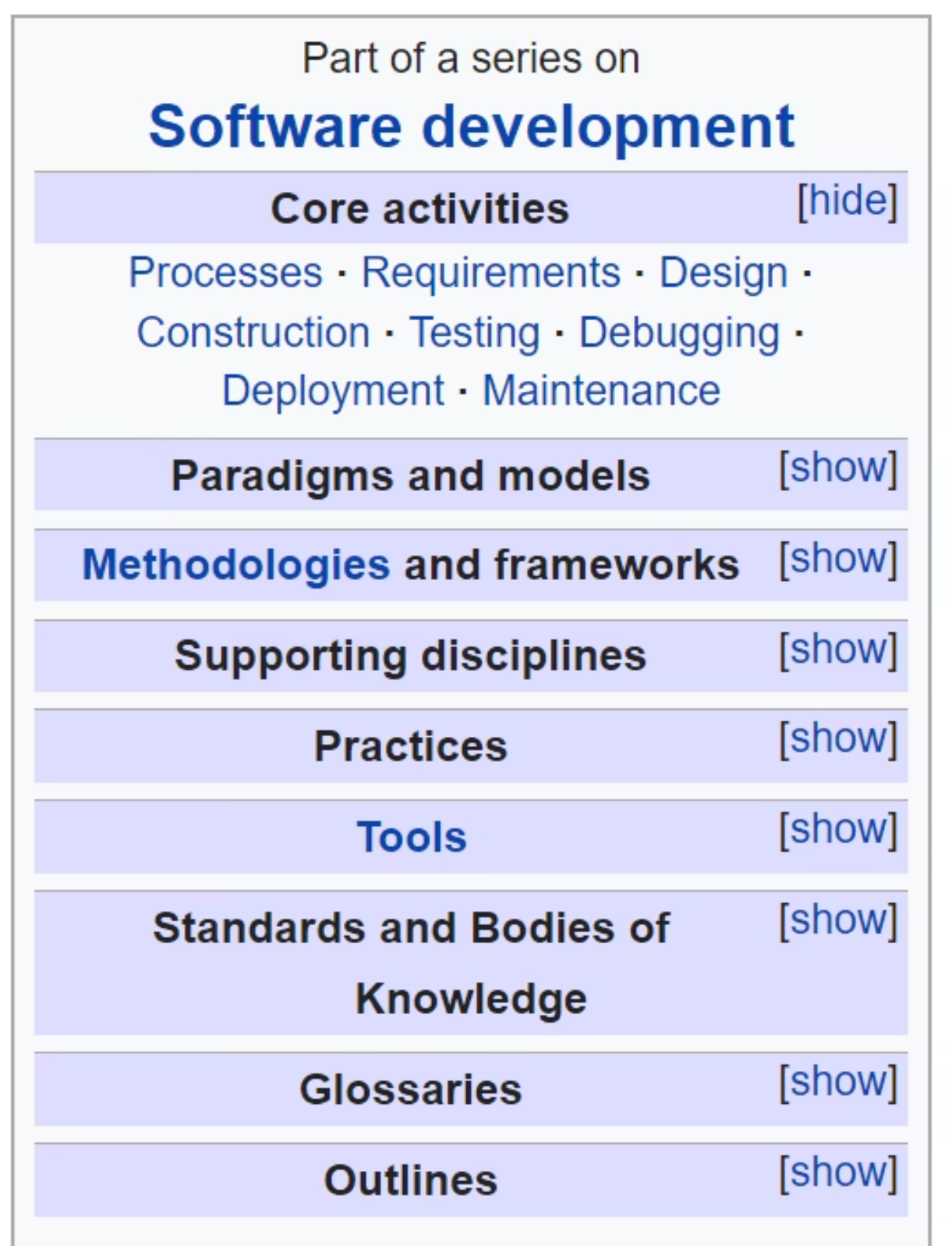

Software Engineering: A Vast Landscape
Software engineering is a comprehensive discipline that encompasses numerous methodologies, practices, and principles. While we can't cover everything in one semester, we'll focus on the most essential topics that prepare you for professional software development careers.
The field continues to evolve rapidly, incorporating new technologies, methodologies, and best practices. Our curriculum emphasizes practical, industry-relevant topics that provide immediate value in your development projects.
Explore Further: For a comprehensive overview of the software engineering field, visit the Software Engineering Wikipedia page to see the full breadth of topics and specializations.

Slide 4
Software Engineering Topics This Semester
Our curriculum covers a carefully selected range of software engineering topics that represent current industry standards and best practices. Each topic builds upon previous concepts, creating a comprehensive learning experience.
1
2
Software Development Lifecycle
Agile Methodologies
Waterfall Model fundamentals and traditional project management approaches
Scrum and Kanban methods for iterative, flexible development
3
4
Data Architecture
Modern Development Practices
Entity-Relationship Diagrams, DBMS concepts, and database connectivity
Web services, global software development, and SCM strategies
5
6
Quality Assurance
Project Management
Testing strategies, test-driven development, and automation frameworks
Requirements management, Scaled Agile Framework, risk assessment, and Creative Commons licensing

Slide 5



The Capstone Project Experience
The capstone project represents the pinnacle of your undergraduate computer science education. Over 10 intensive weeks, you'll transform theoretical knowledge into a tangible, functioning software application that demonstrates your technical capabilities and problem-solving skills.
Design Phase
Conceptualize your application architecture, plan user interfaces, and create technical specifications that guide development
Development Phase
Build your application using industry-standard tools and frameworks, implementing features iteratively
Deployment Phase
Deploy your completed application to production environments, ensuring reliability and accessibility
Project domains span a wide range of modern software applications, including AI/LLM applications, GitHub automation with CI/CD pipelines, full-stack web applications, client-server architectures, database-driven systems, Unicode processing for internationalization, workflow automation, productivity tools, sophisticated user interfaces, and business process optimization.

Slide 6




Tools and Technologies
Throughout the semester, you'll gain hands-on experience with professional development tools and technologies that are essential in today's software industry. These tools will be introduced progressively through various learning activities.
Lectures
Lab Assignments
Individual Assignments
Final Projects
Instructor-led sessions introducing new tools, demonstrating best practices, and exploring advanced concepts
Guided practice sessions where you'll apply new tools in controlled environments with instructor support
Solo projects that deepen your understanding and build confidence with specific technologies
Comprehensive integration of all learned tools and techniques in your capstone application
This multi-faceted approach ensures you develop both breadth and depth in your technical capabilities, preparing you for the diverse challenges of professional software development.

Slide 7
Agile-Scrum Process Simulation
To mirror real-world professional environments, our course operates using Agile-Scrum methodology with GitHub as our primary project management platform. This hands-on experience prepares you for immediate contribution to industry teams.
01
02
Backlog Management
Sprint Planning & Prioritization
Create and maintain a prioritized list of features, user stories, and tasks using GitHub Issues and Projects
Select high-priority items for each development iteration, estimating effort and allocating resources
03
04
Iterative Development
Continuous Feedback
Work in focused sprints, delivering incremental functionality and adapting to changing requirements
Regular code reviews, team check-ins, and instructor consultations to ensure quality and alignment
05
06
Success Metrics
Weekly Demonstrations
Define clear, measurable goals for each sprint and track progress toward project completion
Present completed work to stakeholders, gather feedback, and plan next iterations

Slide 8




Ready to Build Something Amazing?
This semester, you'll transform from students into software engineers, equipped with the skills, tools, and confidence to tackle complex technical challenges. Your capstone project will serve as a portfolio piece that demonstrates your capabilities to future employers.
Set Your Goals
Collaborate Effectively
Define ambitious yet achievable objectives for your capstone project
Work with peers, leverage each other's strengths, and build together
Deliver Excellence
Create software that you're proud to showcase and discuss in interviews
Welcome to ICS499—let's build the future together!

